Slide 1
Text-Based Topic Segmentation
Vaibhav Mallya
EECS 767
Radev

Slide 2
Agenda
Definitions
Applications
Hearst’s TextTiling
Probablistic LSA
Unsupervised Bayes
Discussion

Slide 3
Definitions
Topic Segmentation – Given a single piece of language data how can we effectively divide it into topical chunks?
F.ex: A single news story might cover
Economic situation
A train wreck in Belize
Industrial espionage

Slide 4
Definitions
But what does a topic within a document consist of?
Usually we consider it
Internally consistent subject (nouns, verbs)
Gradual elaboration or exposition on this subject
“Less related” to adjacent topics

Slide 5
Definitions
“Discourse Model” – How do we expect this text was generated, or what is it trying to get across?
Multiple parties sharing points of view?
Single person positing theories?
Debate?
Some algorithms designed for specific discourse models, others more generic
Are results better or worse with one or the other?
How feasible is it to deliver general purpose algorithms?
At the very-least, tokenization strategies must differ (?)

Slide 6
Definitions
Lexical chain – Sequence of related words in text
Somewhat independent of grammatical structure
A good lexical chain captures the “cohesive structure” of the text
John bought a Jag. He loves the car.
Car -> Jag
He -> John

Slide 7
Applications
Applications lie primarily in unstructured dialogue and text
Figuring out how broad-based a news story or article may be
Topic shifts in dialogue (does Google Voice transcription use this?)
Assisting with meeting note transcription

Slide 8
Applications
A lot of topic segmentation is already done by hand and used in search.
Wikipedia, Java: http://www.google.com/search?q=sorting+algorithms

Slide 9
Hearst’s TextTiling
UC Berkeley and Xerox PARC
Early topic segmentation algorithm
Two possible goals
Identify topical units
Label contents meaningfully
Paper focuses on the former – simply identifying unmarked borders

Slide 10
Hearst’s TextTiling
Some prior works model discourse as hierarchical
Topics, sub-topics, sub-sub-topics
Hearst focused on coarse-grained linear model
Hence “tiling”

Slide 11
Hearst’s TextTiling
“The more similar two blocks of text are, the more likely it is the current subtopic continues”
Tokenization
Similarity Determination
Boundary Identification.

Slide 12
Hearst’s TextTiling
1) Tokenization
Basic tokens are “pseudosentences” aka token-sequences
Token-sequences – strings of tokens of length ‘w’
Stopword list used (frequent words eliminated)
Each (stemmed) token stored in table, along with how frequently it occurs in each token-sequence

Slide 13
Hearst’s TextTiling
2) Similarity Determination
Use a sliding window
Compare blocks of token-sequences for similarity
These are “paragraphs” in this scheme
Blocksize parameter = k,
Blockwise similarity calculated via cosine measure

Slide 14
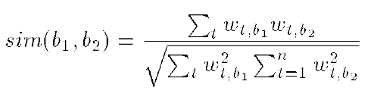
Hearst’s TextTiling
Blocks b1 and b2
k token-sequences eac
t ranges over all tokenized terms
wt,b1 is weight assigned to term t in block b1
Weights = frequency in block
High: Closer to 1
Low: Closer to 0

Slide 15
Hearst’s TextTiling
But this is a sliding window
First, second blocks span [i-k, i] and [i+1, i+k+1] respectively
We are actually assigning number between i,i+1
Use smoothing with window size of three

Slide 16
Hearst’s TextTiling
3) Boundary Identification
Now we can use our sequence of similarity scores
Find “changes” over the line to calculate “depth scores”
Find every peak pi
Now find relative height: hi = (pi - pi+1) + (pi - pi-1)
“Highest” hi values correspond to boundaries
As described in paper, some experimentation is necessary; they come up with some threshold value they can use.

Slide 17
Hearst’s TextTiling
Evaluation criteria
Compare against human judgment of topic segments
This paper uses Stargazers, a sci-fi text

Slide 18
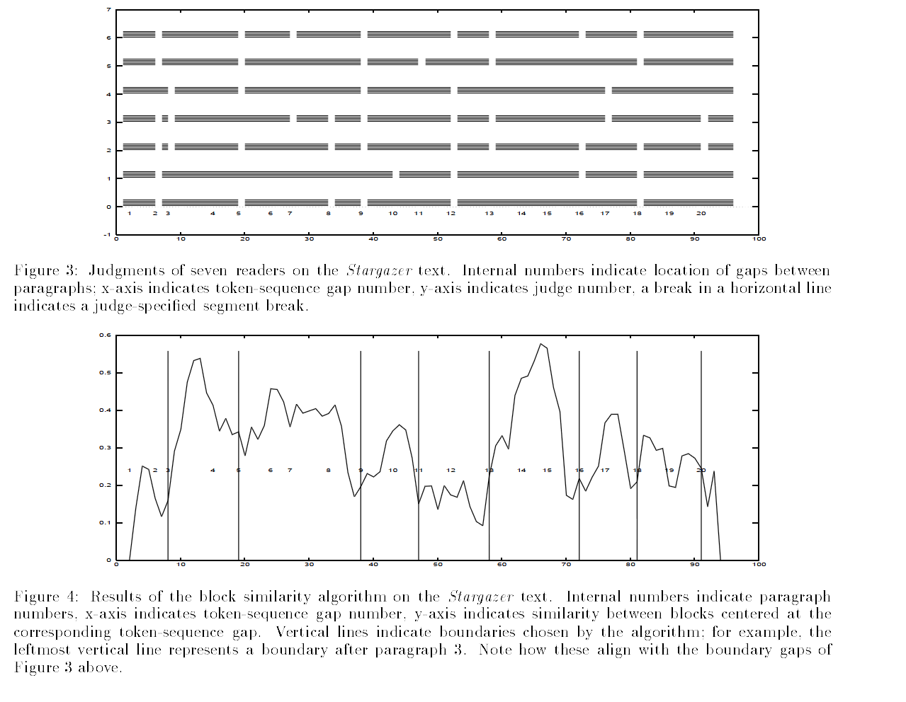
Hearst’s TextTiling

Slide 19
Demo
Implementation example
Python Natural Language Toolkit
Not true to the original paper, but a good demonstration (fits on existing paragraph boundaries)

Slide 20
Probabilistic LSA
Brants, Chen, Tsochantaridis
PARC, PARC, Brown University
Applies PLSA to topic segmentation problem
Then selects segmentation points based on the similarity values between pairs of adjacent blocks.

Slide 21
Probabilistic LSA
Review of Latent Semantic Analysis
Matches synonymous words
Begin with a straight high-dimensional word-count matrix
Apply Singular Value Decomposition
Obtain simpler “semantic space”
Similar terms and documents should be close or even adjacent

Slide 22


Probabilistic LSA
Review of Probabilistic Latent Semantic Analysis as described in the paper
Conditional probability between documents d and words w is modeled through latent variable z
P(w|z), P(z|d)
z is a kind of class or topic
Joint probability is then
Then apply Expectation-Maximization to maximize

Slide 23
Probabilistic LSA
1) Preprocessing
Tokenize (ignoring stop-words)
Normalize (lower-case)
Stem
Identify sentence boundaries

Slide 24
Probabilistic LSA
2) Blockify
Elementary block is (in this case) a “real” sentence
Blocks are sequences of consecutive elementary blocks
In actual segmentation, use sliding window to create blocks
Each block is composed of constant h number of elementary blocks

Slide 25
Probabilistic LSA
2) Blockify (continued)
Each block represented by term vector f(w|b)
Experimentally “good” number of latent classes:
Z ~=~ 2*number of human-assigned topics

Slide 26

Probabilistic LSA
3) Segmentation
Locations between paragraphs are used as starting points
Folding-in performed on each block b to compute distribution
Compute P(z|b), P(w|b)
P(w|b) = Estimated distribution of words for each block b =

Slide 27
Probabilistic LSA
3) Segmentation (continued)
This is done for all words w
Calculate blockwise similarity, find “dips” (local minima)
Calculate relative size of dip (equation in paper)
A priori knowledge of number of segments N lets us terminate after finding N dips
Otherwise termination is determined by threshold (paper provides value of 1.2)

Slide 28
Probabilistic LSA
Evaluation
Authors choose a fixed training corpus and fixed actual corpus-
They use word error rate and sentence error rate as metrics (still not sure what these are)
WER: Probability that that a randomly chosen pair of words at distance kw words apart is erroneously classified
SER: Same as above but for sentences
Comparison against some other algorithms (including TextTiling) is done as well.

Slide 29
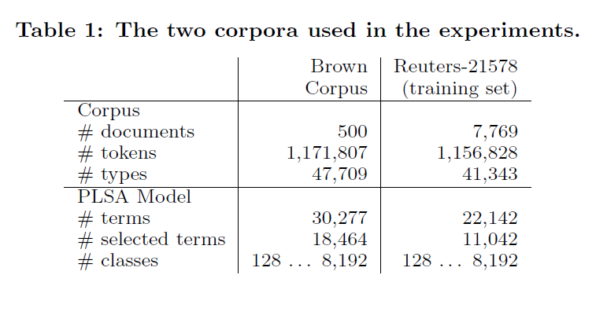
Probabilistic LSA

Slide 30
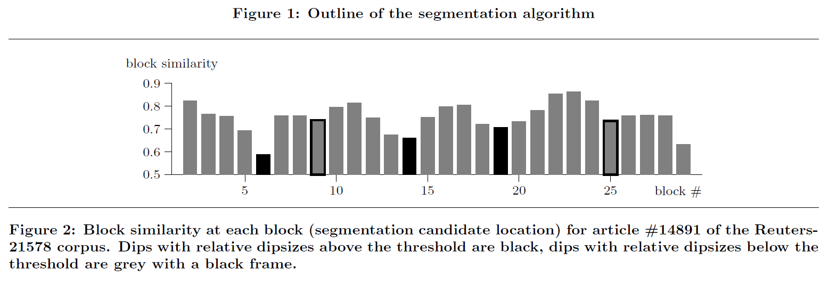
Probabilistic LSA

Slide 31
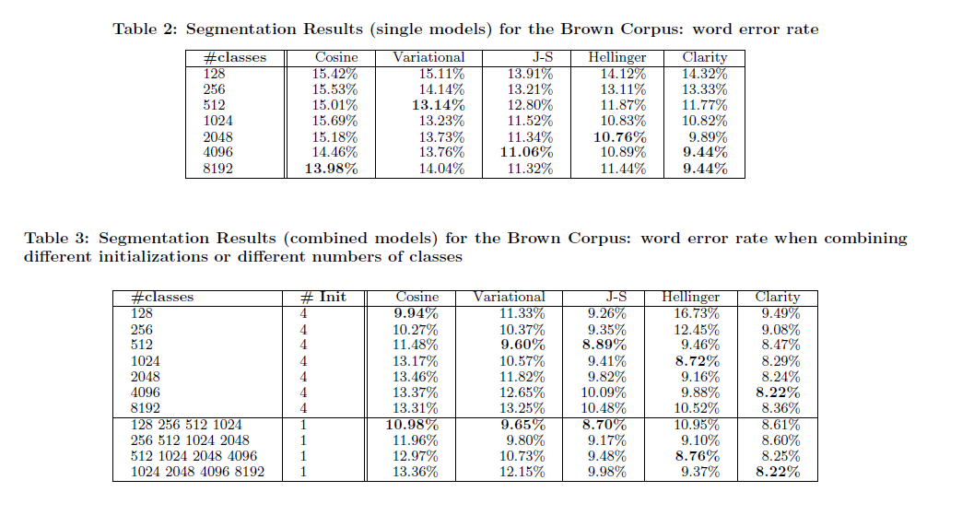
Probabilistic LSA

Slide 32
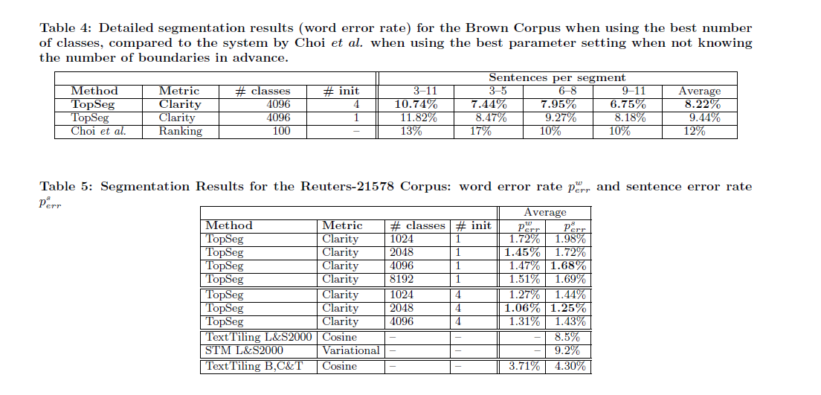
Probabilistic LSA

Slide 33
Unsupervised Bayes
Jacob Eisenstein and Regina Barzilay, CSAIL, MIT
Relatively recent paper (2008)

Slide 34
Unsupervised Bayes
As we’ve seen so far, text has been treated as raw data
“Lexical cohesion” thus far only measure of topics
No semantic information explicitly retained or utilized
For the purposes of topic segmentation, there is one obvious semantic element that somehow could be incorporated:

Slide 35
Unsupervised Bayes
Transition Words and Cue Phrases
“Now”, “Then”, “Next”
“As previously discussed”, “On a Related Note”
Obviously, these give embarrassingly obvious indicators that a topic will probably change

Slide 36
Unsupervised Bayes
This method “situates lexical cohesion within a Bayesian Framework”
Still use a linear discourse structure
Words are drawn from a generative language model
Use known cue phrases as guide

Slide 37
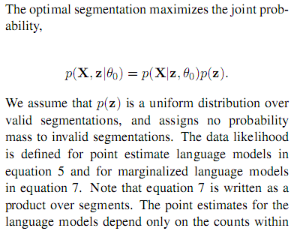
Unsupervised Bayes
[lots of math…]

Slide 38
Unsupervised Bayes
Evaluation functions:
WindowDiff (Pevzner and Hearst, 2002)
P_k (Beeferman et al, 1999)
Both pass a “window” through a document,
Assess whether sentences on “edge” of the window are segmented w.r.t each other
WindowDiff is slightly “stricter”

Slide 39
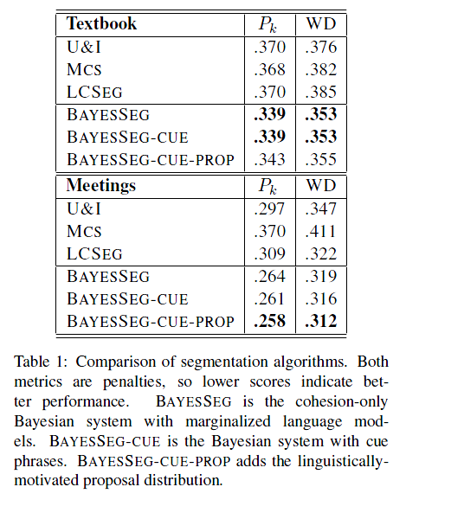
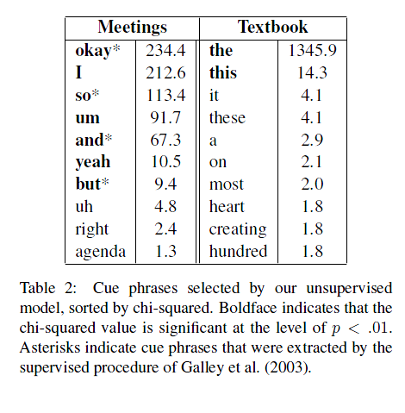
Unsupervised Bayes

Slide 40
Unsupervised Bayes
Results
Cue phrases are useful, but their total effectiveness is dataset dependent
Writers do not always use cue phrases consistently
Cue phrases may be more useful for speech/meeting transcription and analysis than narration or literature

Slide 41
Discussion
Potential future, or unexplored applications?
Analogues possible in other kinds of text?
Used to assign complexity scores to literature?
Maybe incorporate into Fleisch-Kincaid?
Focus is on complete articles, stories, etc
What about streaming or live news?

